Slide 1


Responsive design

Slide 2

Topics
Introduction
Responsive design
Square Bracket Notation in Tailwind CSS

Slide 3
Introduction
Responsive design is an essential aspect of web development that ensures your website or web application looks and functions well across different devices and screen sizes. Tailwind CSS provides a comprehensive set of utilities and classes to create responsive designs efficiently.

Slide 4
Responsive design
Tailwind CSS simplifies the process of building complex responsive interfaces by allowing you to apply utility classes conditionally at different breakpoints. This means you can effortlessly design responsive layouts directly in your HTML, without the need to write separate CSS code or navigate away from your markup.
Breakpoint | Minimum width | CSS
sm | 640px | @media (min-width: 640px) { ... }
md | 768px | @media (min-width: 768px) { ... }
lg | 1024px | @media (min-width: 1024px) { ... }
xl | 1280px | @media (min-width: 1280px) { ... }
2xl | 1536px | @media (min-width: 1536px) { ... }
Syntax:
{breakpoint}:{classes}

Slide 5
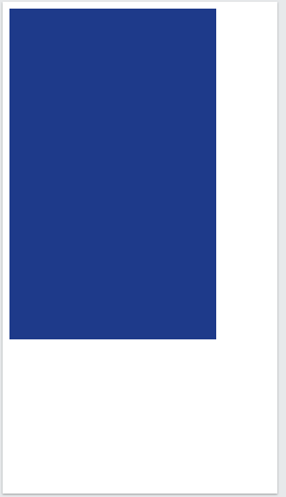
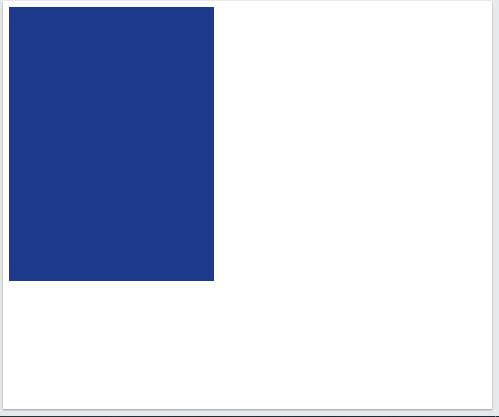
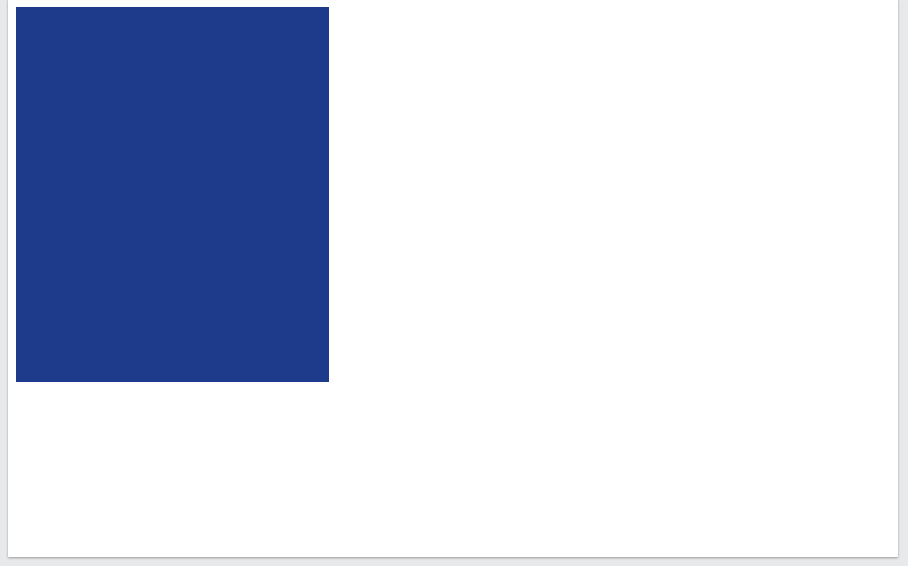
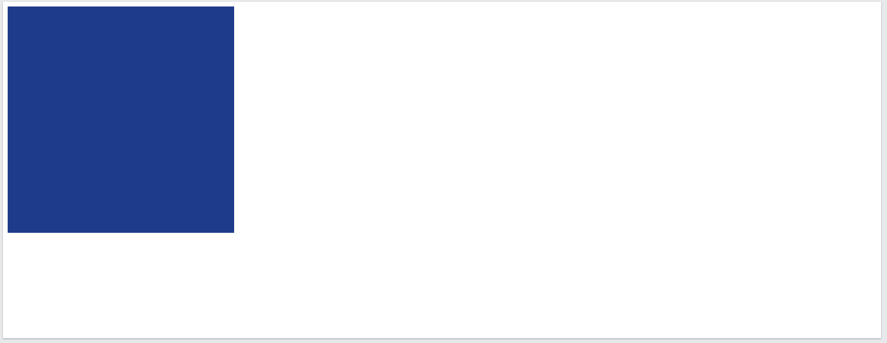
Responsive design
<!DOCTYPE html>
<html>
<head>
<script src="https://cdn.tailwindcss.com"></script>
</head>
<body>
<div class='m-2 w-60 sm:w-72 md:w-80 lg:w-96 h-96 bg-blue-900'></div>
</body>
</html>
Result:
Screen size from 0 px to 639 px
Screen size above 640 px to 767 px
Screen size above 768 px to 1023 px
Screen size 1024 px and above

Slide 6
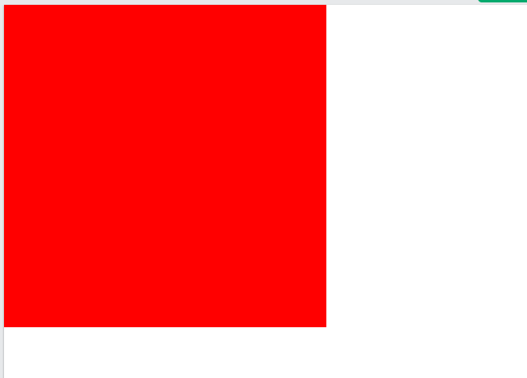
Square Bracket Notation in Tailwind CSS
This Tailwind CSS feature allows the developer to include custom CSS values instead of using the default predefined Utility classes. When building the application, this feature gives the developer the freedom to abandon the limitations of the theme and adopt a modern strategy as needed. This helps developers to write the custom css within tailwind itself. Moreover, It allows you to use the classes dynamically.
Syntax:
Example:
Property-[Custom Value]
<div class="bg-[red] w-[400px] h-[400px]">hello</div>
Result:

Slide 7
THANK YOU

